Slide 1
P.R.GOVT.COLLEGE(A),KAKINADA
ENGLISH GRAMMAR
ARTICLES Power Point Presentation BY B.N.PRATHYUSHA,
Faculty in English

Slide 3
ARTICLES
Definition : - An article is a word used to modify a noun, which is a person, place , object or an idea.
Technically, an article is an Adjective, which is any word that modifies a Noun.
Usually adjectives modify nouns through description, but articles are used instead to point out or refer to nouns.

Slide 4
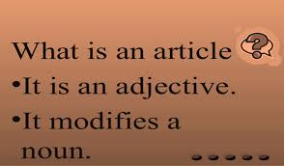

Slide 5
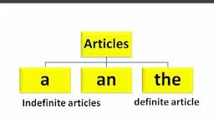
Types of Articles
Definite Article
Indefinite Articles

Slide 6
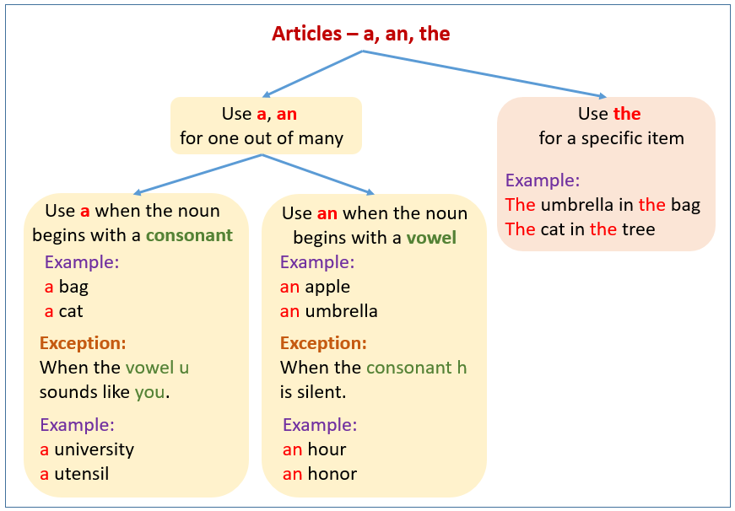

Slide 7
INDEFINITE ARTICLES
A and An are called indefinite articles.
A and An do not refer to any particular or definite person, place or thing
Examples : an umbrella
a boy
a book

Slide 9
Definite Article
The is called the definite Article, because it always points out some particular object.
Example : This the boy who had stolen my purse.

Slide 12
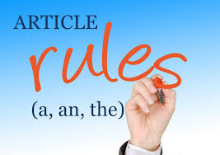

Slide 15
Rules A is used
A is used before a consonant – b,c,d,f,g,h,j,k,l,m,n,p,q,r,s,t,v,w,x,y,z
Example : a boy
a cow
a pen

Slide 17
A IS USED
A is also used before a word beginning with a vowel but sounding like a consonant.
Example : a one rupee coin
a European
a utensil

Slide 18
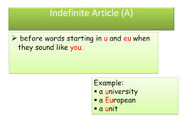

Slide 19
A is Used
If sentence is spoken empathetically
Example : Rome was not built in a day

Slide 20
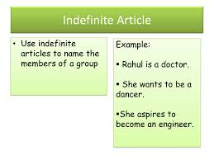

Slide 21
An is used
AN is used before a word beginning with a vowel – a,e,i,o,u
Example : an umbrella
an egg
an ice cream
an orange
an apple

Slide 22
AN is used
An is used before a word beginning with a consonant but having a Vowel sound.
Example : an M.L.A
an hour
an honest man

Slide 25
The is used
The is used before a word denoting a particular person or thing.
Example : Let’s go to the Cinema
Before the titles : The great
Before the words denoting numbers, weight –
Example : cloth is sold by the metre.

Slide 28
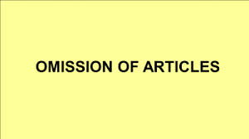

Slide 31
