Slide 1
UPAGUPTA BY RABINDRANATH TAGORE
DEPARTMENT OF ENGLISH
P.R.GOVERNMENT COLLEGE KAKINADA

Slide 3
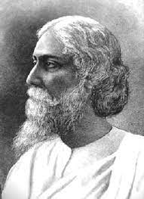

Slide 4
Two different scenes which were separated in time are described in the poem. Lines 1-12 are in the first scene. It is in the rainy season. Lines 13-22 are in the second scene. It is in the spring season and the branches of the trees were full of flowers.

Slide 5
Upagupta, the disciple of Buddha, lay sleep in the dust by the city wall of Mathura. Lamps were all out, doors were all shut, and stars were all hidden by the murky sky of August. Whose feet were those tinkling with anklets, touching his breast of a sudden? He woke up startled, and a light from a woman’s lamp fell on his forgiving eyes.

Slide 6
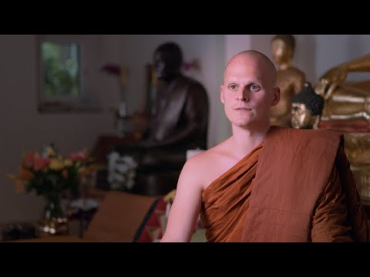
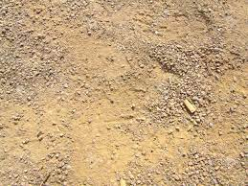

Slide 7
It was dancing girl, starred with jewels, Wearing a pale blue mantle, drunk with the wine of her youth. She lowered her lamp and saw young face austerely beautiful. “Forgive me, young ascetic,” said the woman, “Graciously come to my house. The dusty earth is not fit bed for you.”

Slide 8
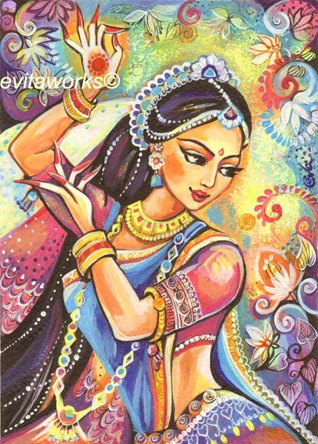

Slide 9
The young ascetic answered, “Woman, go on your way; When the time is ripe I will come to you.” Suddenly the black night showed its teeth in a flash of lightening. The storm growled from the corner of the sky, and The woman trembled in fear of some unknown danger.

Slide 11
It was evening of a day in April, in spring season. The branches of the way side trees were full of blossom. Gay notes of a flute came floating in the warm spring air from a far. The citizens had gone to the woods for the festival of flowers. From the mid sky gazed the full moon on the shadows of the silent town. The young ascetic was walking along the lonely street, While overhead the love-sick koels uttered from the mango branches their sleepless plaint. Upagupta passed through the city gates, and stood at the base of the rampart.

Slide 14
Was that a woman lying at his feet in the shadow of the mango grove? Struck with black pestilence, her body spotted with sores of small-pox, She had been hurriedly removed from the town To avoid her poisonous contagion. The ascetic sat by her side, took her head on his knees, And moistened her lips with water, and smeared her body with sandal balm. “Who are you, merciful one?” asked the woman. “The time, at last, has come to visit you, and I am here,” replied the young ascetic.

Slide 15
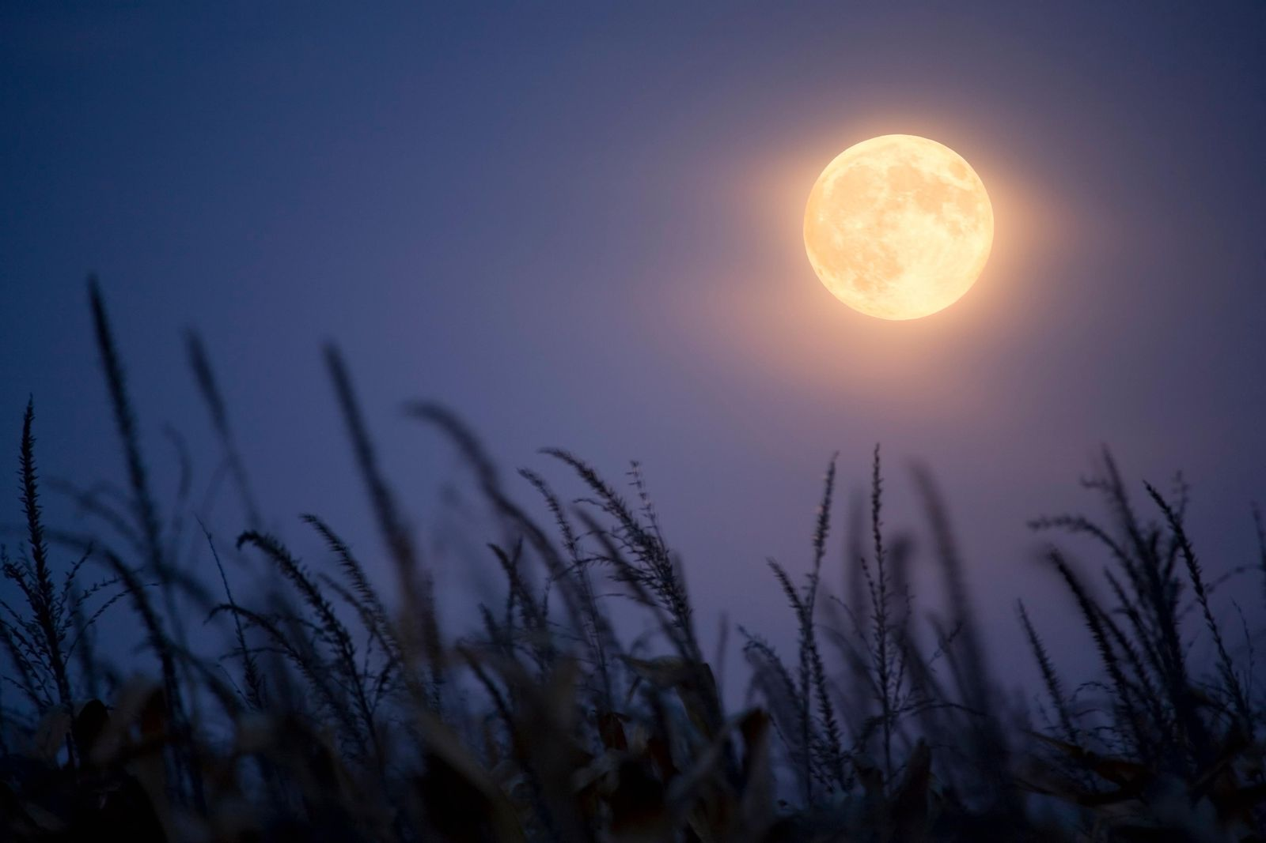

Slide 16
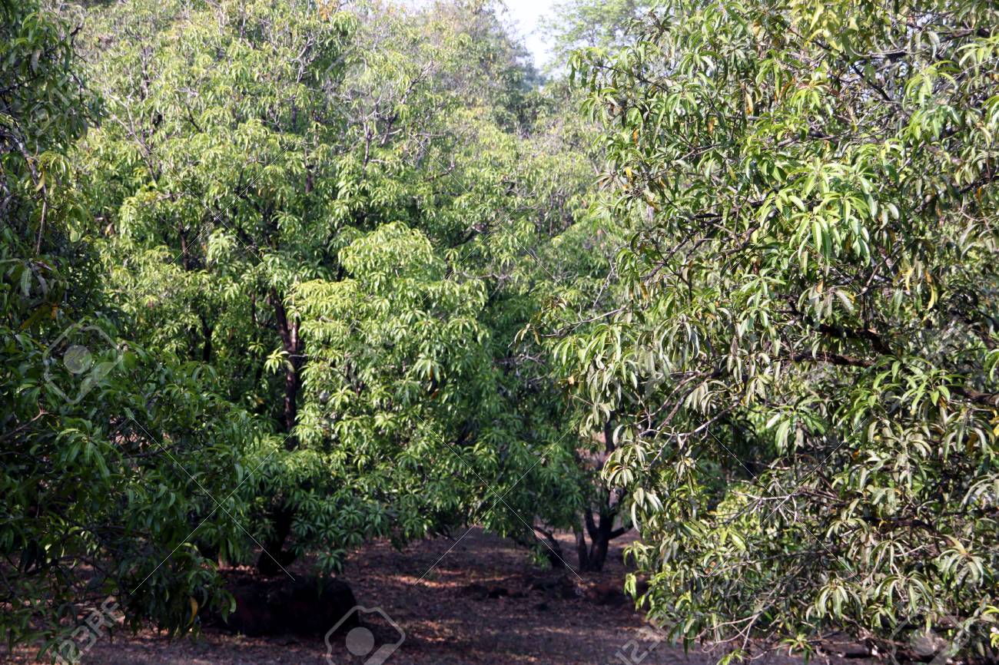

Slide 17
First Scene (1-15 Lines) Upagupta lay asleep in the dust by the city wall of Mathura. He slept in the dust because he was a saint and he hated comfort, luxury and wealth. The night was described as murky because it was dark and unpleasant every where. It was the rainy season. So, people stayed indoors and they closed the doors and put out all lights. At that time of the night the dancing girl was returning home from the royal court. As it was dark at that time, she approached the city wall and couldn't see the path clearly. She touched Upagupta with her feet. He didn't mind her feet touching him since it wasn't deliberate attempt.

Slide 18
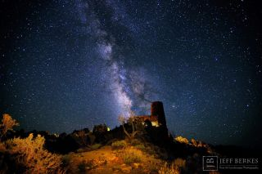

Slide 19
(6-10 Lines) The dancer was attracted by Upagupta's austerely handsome face. She thought that the dusty earth wasn't the proper place for the ascetic to sleep on. So, she requested Upagupta to come to her house. But he was a saint. He hated comfort, wealth and worldly pleasure. So, he declined the dancer's invitation of going with her to her house as he understood what she meant. He promised her that he would visit her house at an appropriate time by saying that Woman, go on your way! His words your way have a special significance. He asks her to go on with her worldly pleasures. She is too young to renounce material and physical pleasures. Her way was to enjoy herself. But he was a saint and renounced all worldly pleasures. His way was to lead a simple and spiritual life.

Slide 20
(11-12 Lines) When the young ascetic had spoken his words, the black night showed its teeth in a flash of lighting and a storm growled from the corner of the sky. Due to this, the dancing girl trembled in fear.
Second Scene It is the spring season. The branches of the trees were full of flowers. The air was warm and the breeze made musical sounds. The citizens went to the trees to attend the festival or flowers

Slide 21
(16-20 Lines) The town was silent and there was no passerby because most of the citizens left for the woods to attend the festival of flowers. The dancing girl was suffering from a deadly disease and she was driven away from the town. She had severe sores on her body. They were very painful and the disease was contagious. She lay in the shadow of the city wall suffering. She should be looked after by someone. She was in dire need of an attendant. The time for the ascetic, Upagupta, had come to serve her. He sat by the side of the suffering woman. He took her head on his knees, watered her lips, applied some balm to her sores and showed great care towards her.

Slide 22
(21-22 Lines) The dancing girl asked who the merciful one was. He was Upagupta. He said that it was the right time for him to visit her because the duty of an ascetic was to render service to humanity.

