Slide 1
COROMANDAL FISHERS POEM
P.R.G.C(A), KAKINADA
DEPARTMENT OF ENGLISH

Slide 6
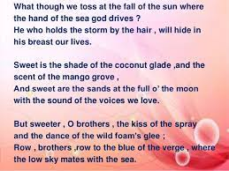

Slide 7
Sarojini Naidu in the poem, 'The Coromandel Fishers', has described the beauty of nature and the folk culture of the Coromandel Coast of India. It depicts the relationship of fishermen with nature. Nature stands as a symbol of beauty that expresses the optimistic view of life.

Slide 9
She asks the fisher folks to wake up and offer their prayers to the morning light. The wind is calm and quiet like a child that sleeps soundly after crying the whole night. She asks the fishermen to gather the nets and set their catamarans free and set out into the sea to gather the leaping wealth of the tide as they are the kings of the sea. She asks the fisher folks not to delay and quickly set forth in the track of the sea gulls call.

Slide 12
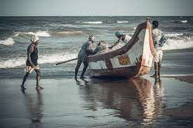

Slide 15
She comforts the folks by saying that the sea is their mother, the cloud is their brother and the waves toss their boats at sunset and drive them far, God who controls the storm will protect their lives from its rage.

Slide 18
She also says that the coconut glade gives shade and the sweet fragrance of the mango grove is soothing. Moreover the sight of the sands on a full moon night is very beautiful, mixed with the voices of the birds early at dawn. But beyond all this, the kiss of the spray and the dance of the wild foam in joy is far sweeter. So she asks the fisher folks to row their catamaran to the edge of the borders, the horizon, where the low sky appears to unite with the sea.

Slide 19
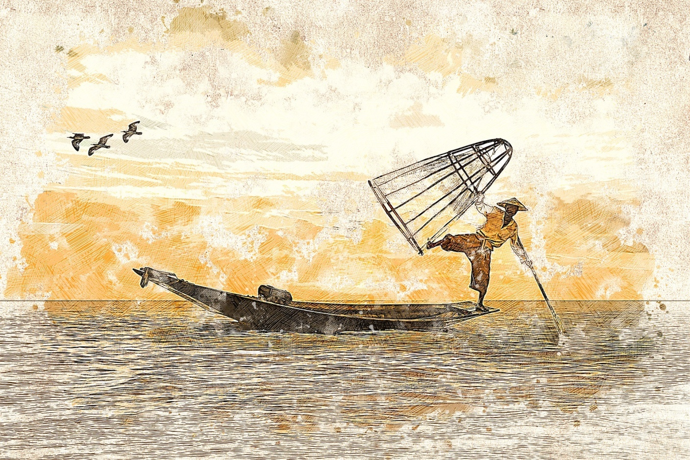

Slide 20
The poetess Sarojini Naidu was a distinguished poet, renowned freedom fighter and one of the greatest creators of her time. In the poem 'The Coromandel Fishers', she addresses the fishermen as brothers. She considers herself one among them. The poem is a call to the fishermen to gather their nets and set to said to catch fish. Addressing them as their comrade, she calls them to join her on the fishing expedition. She expresses her concern for them and asks them to rise and at the break of dawn to catch the leaping wealth of the tide. This helps in building a rapport with the fishermen. She considers them as her own kith and kin.

Slide 21
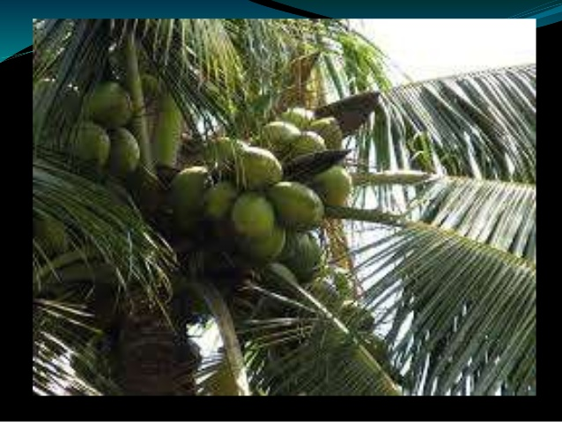

Slide 22
The poem 'The Coromandel Fishers' by Sarojini Naidu is a call from the poetess to all poets to go on a fishing expedition at the time of dawn and return safe and sound by dusk. The fishermen who call themselves as the kings of the sea love the sweetness of the coconut glade, the scent of the mango grove, the golden sand on a full moon night and the voices of the birds at the break of day and the sound of the waves. But beyond all these they find the kiss of the spray and dance of wild foam in joy far sweeter.

Slide 23
The poetess Sarojini Naidu possesses a sharp aesthetic sensibility and is an admirer of the varied colors of nature. She has beautifully said that the fishermen set out for the sea at dawn when the wind is still sleeping as quietly as a child that sleeps after crying the whole night. Everything around is quiet and calm. It is the most suitable time for the fishermen to set out on their fishing task. This is an appropriate time for the fishermen to set out their fishing task. This is an appropriate time for the fishermen to set out for the sea gathering their nets and setting their catamarans free.

