Slide 1
ONCE UPON A TIME BY GABRIEL OKARA
Department Of English,
P.R.Government College, Autonomous
Kakinada

Slide 2
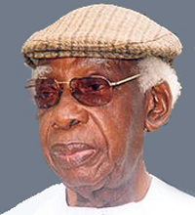
Gabriel Okara About The Poet
The poet of the poem “Once upon a time” is Gabriel Okara who is a Nigerian. He was born on 24th of April in the year 1921.In that year Nigeria got independence from Britain so at that time they were still influenced by the British culture

Slide 3
Back Ground of the poem
The background of the poem is that he is remembering the way people used to behave and interact with each other and he is comparing it with how people interact with others now. How the people used to do things with their hearts and with pleasure and happiness. It describes what happens when a traditional African culture and civilization meets with the western culture.

Slide 4
Introduction
The poem is a conversation between a father and his son where the son does things with emotion and the father wants to forget his fake personality and re-learn and create real personalities from his son. And he is asking the son to show him how to express true love and show real personality to others.

Slide 5
First Stanza
Once upon a time, son, they used to laugh with their hearts and laugh with their eyes: but now they only laugh with their teeth, while their ice-block-cold eyes search behind my shadow.

Slide 6
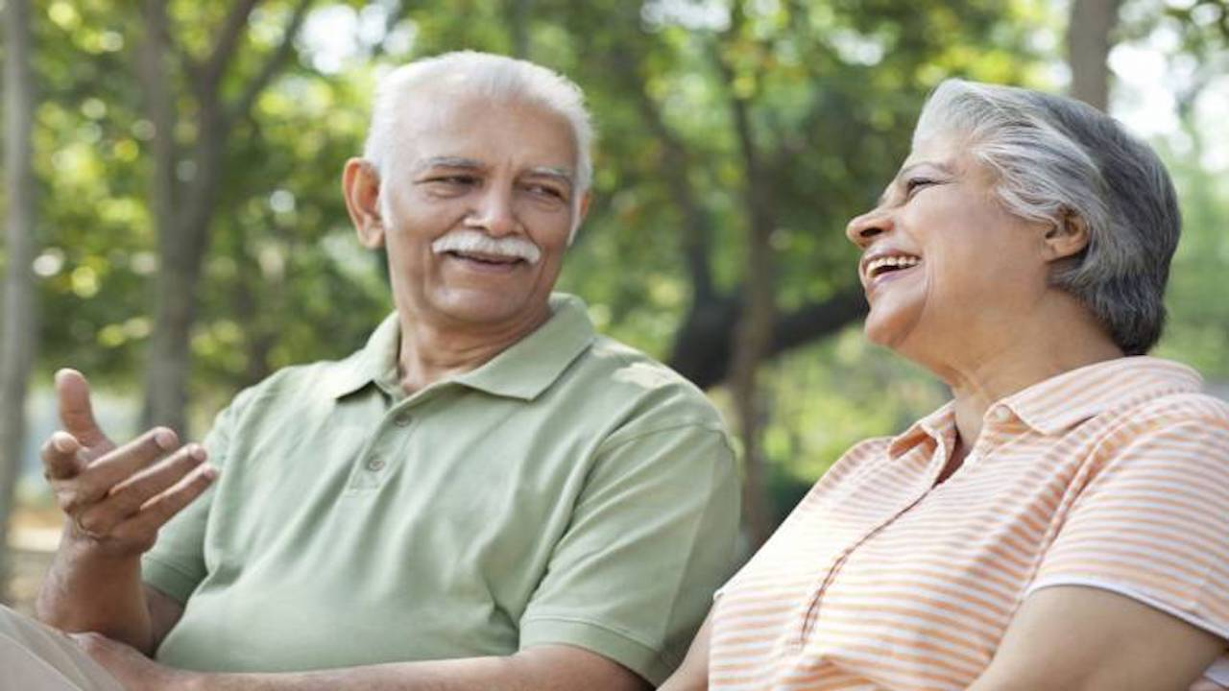

Slide 7
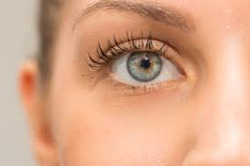
It the first stanza the author mentions that people used to laugh with their heart they used to laugh with their emotions, when they would laugh they would do it wholeheartedly and with warmth and they used to laugh with their eyes and show pleasure with them.

Slide 8
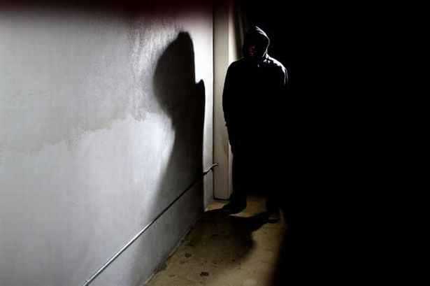
And now they do it with only their teeth not with their heart, meaning they do not really want to laugh but do it just to get closer to you and with their darky gloomy cold eyes they watch you and wait for you from the corner of their eyes waiting for you to leave “search behind my shadow”.

Slide 9
Second Stanza
There was a time indeed they used to shake hands with their hearts: but that’s gone, son. Now they shake hands without hearts while their left hands search my empty pockets.

Slide 10
In the second stanza he further talks about the personalities of the people of the past he says “they used to shake with their hearts” here he is trying to say that when you would meet each other you will shake their hands with pleasure and with warmth and do it willingly.

Slide 11
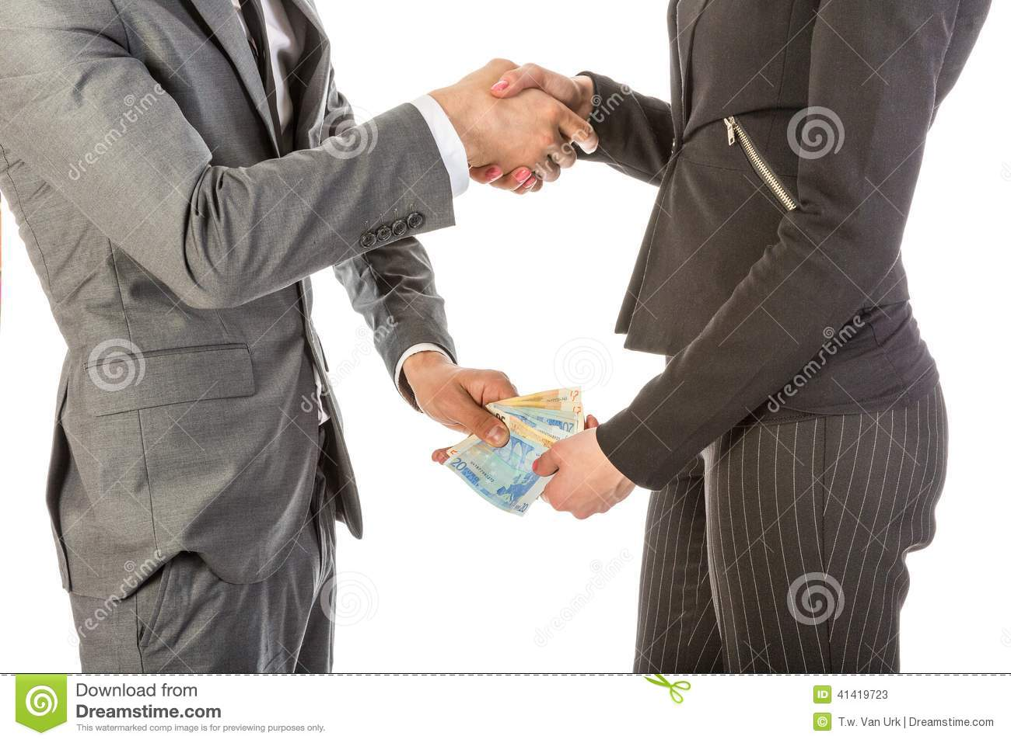
“While their left hands search my empty pockets” from this we can see that they are trying to use him to get to his money or receive something from him. This also shows that the people’s personalities are not real and true

Slide 12
Third Stanza
‘Feel at home!’ ‘Come again’: they say, and when I come again and feel at home, once, twice, there will be no thrice- for then I find doors shut on me.

Slide 13
In the third stanza he is talking about when people ask you to come again and say “feel at home” you go there once, twice and the third time they will not let you in thinking that you are a pest and that they do not wanted to see you anymore. The words “feel at home” is used for when you want a guest to feel welcomed and that they belong in that household.

Slide 14
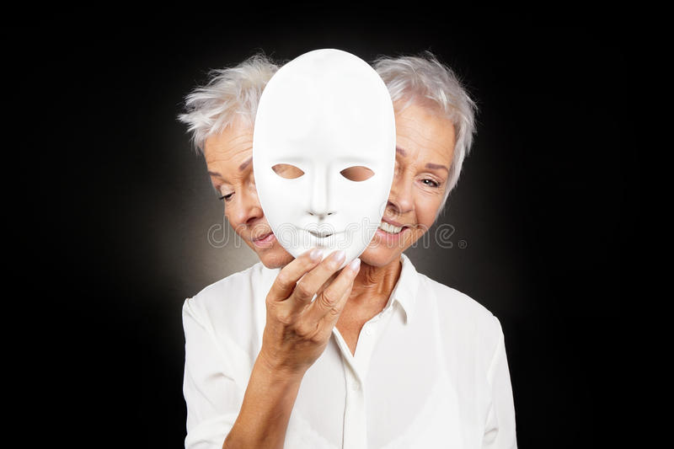
Fourth Stanza
So I have learned many things, son. I have learned to wear many faces like dresses – home face, office face, street face, host face, cocktail face, with all their conforming smiles like a fixed portrait smile.

Slide 15
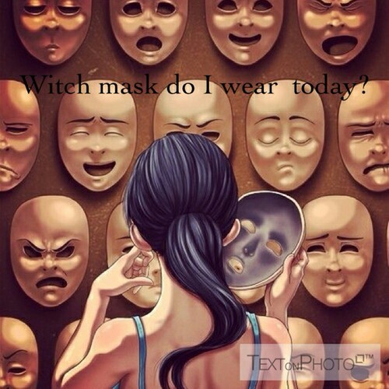
In the fourth stanza he talks about how he has learned to put on faces like how outfits and masks are put on at different times, and with different people you act differently, for example in the office you act in one way to a person but when you meet them on the street you act another way to them, and how all the faces that people have on different occasions.

Slide 16
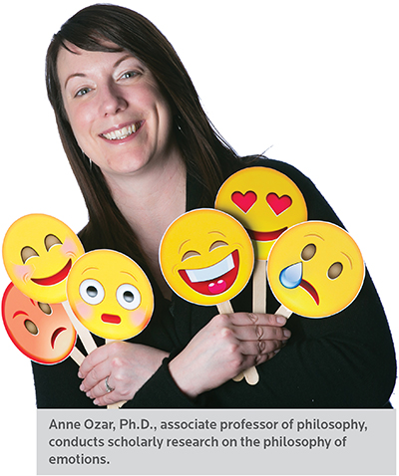
He says “I have learned too” which is suggesting that he has also changed with the change of the people around him. he also mentions “with all their conforming smiles like a fixed portrait” suggesting that they all have the same smile all the time not showing any true emotion.

Slide 17
Fifth Stanza
And I have learned too to laugh with only my teeth and shake hands without my heart. I have also learned to say,’Goodbye’, when I mean ‘Good-riddance’: to say ‘Glad to meet you’, without being glad; and to say ‘It’s been nice talking to you’, after being bored.

Slide 18
Fifth Stanza Explanation
In the fifth stanza he says that he has also been influenced by the people around him and he has learned to keep his true personality a secret and show the world a fake personality, “to laugh with only me teeth” this part is connected with the part in the first stanza “they only laugh with their teeth” from this you can see a comparison of what people do and what he does now. This also shows that he has changed to blend in with the environment.

Slide 19
Here in the part where he says “I have also learned to say `Goodbye’ when I mean `Good-riddance’ that is pointing out to the fact that they will, without thinking and without meaning it they will say “Goodbye”. He mentions forward “that Glad to meet you” meaning that he is happy to see you and is happy with your presence “without being glad” meaning that the did not wanted to talk to you and they disliked your presence and if they could they would of avoided you and “it’s been nice talking to you, after being bored” saying that they say things that they do not mean

Slide 20
Sixth Stanza
But believe me, son. I want to be what I used to be when I was like you. I want to unlearn all these muting things. Most of all, I want to relearn how to laugh, for my laugh in the mirror shows only my teeth like a snake’s bare fangs!

Slide 21
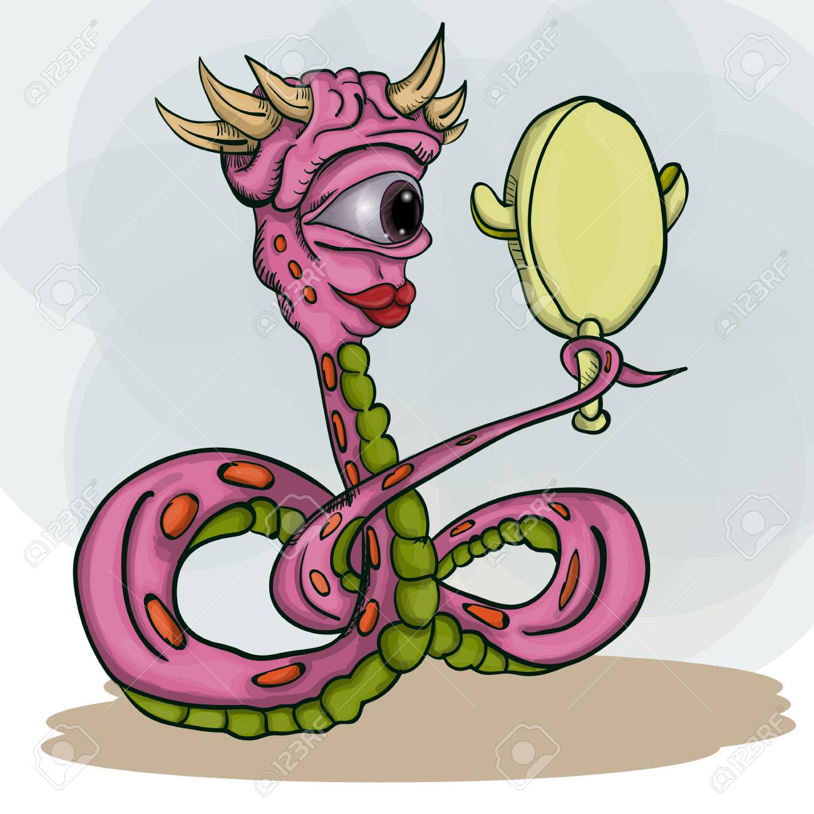
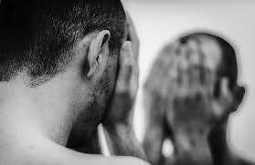

Slide 22
Final words
In the sixth stanza he concludes it all saying that he does not like what he has become and he wants to be like he used to be when he was like a child so small and innocent. He points out that he really wants to learn how to laugh with emotions like you really mean it and he compares his laugh like that of a snake’s fangs that shows only the teeth snakes are those menacing creatures that are full of venom and can never be trusted and to compare his laugh with a snake gives the image that the man really does not like his fake personality. This stanza sums it well by giving the image to the reader that he is not happy and satisfied with himself.

Slide 23
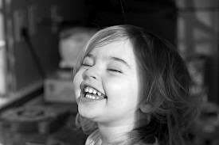
Last stanza
So show me, son, how to laugh; show me how I used to laugh and smile once upon a time when I was like you.

Slide 24
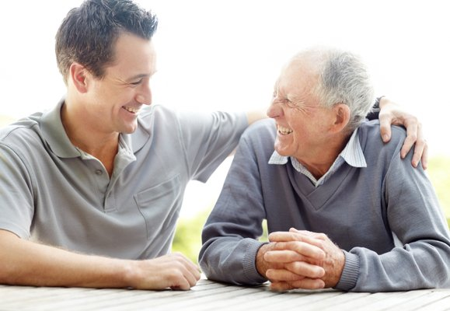
Conclusion
In the last stanza father asking and pleading to his son to show him how to laugh and smile like he did when he was a child. The last line sums up the entire poem really well making sure that all strings are tied.

